Slide 1
International Conference Pandemic Crises in Rural Villages
Universidade de Tràs-os-Montes e Alto Douro
(Vila Real, 13 de septiembre de 2022)
Learnings, Reflections and Considerations of
the COVID Pandemic from a rural citizen
Martín Gómez-Ullate
Sofía Silveira
Grupo de Investigación “Patrimonio Musical, Cultura y Educación”
Universidad de Extremadura
https://ror.org/0174shg90
Fondo Europeo de Desarrollo Regional
Una manera de hacer Europa

Slide 2
TOOLS FOR CITIZENSHIP IN PANDEMIC CRISIS

Slide 3
COMMON SENSE
MEDIATIC SENSE
POLITICAL SENSE
SCIENTIFIC SENSE
…

Slide 4
COMMON SENSE
BASED ON DIRECT AND INDIRECT EXPERIENCE
(FACTS AND INFERENCES)

Slide 5
MEDIATIC SENSE
BASED ON MAXIMIZING AUDIENCE
(ESPECTACULARITY)

Slide 6
POLITICAL SENSE
BASED ON MAXIMIZING VOTES
(DISTRIBUTION OF POWER AND WEALTH)

Slide 7
SCIENTIFIC SENSE
BASED ON AGREED PRINCIPLES AS CONTROLLED METHODOLOGIES, STATISTICS, PROBABILITY
(SYSTEMATIC DOUBT)

Slide 8
CULTURAL CONTEXT
AS HUMAN BEINGS, CULTURE SHAPES ALL THOSE SENSES, THAT CONVERGE IN A CONCRETE PLACE AND TIME

Slide 9
CULTURAL CONTEXT
AS CITIZENS IF WE ARE NOT SPECIALIST (BIOLOGISTS, EPIDEMOLOGISTS, SURGEONS) WE ONLY HAVE OUR COMMON SENSE BUT CAN BORROW FROM THE SCIENTIFIC SENSE SOME PRINCIPLES AS CRITICAL THINKING AND SISTEMATIC DOUBT TO ENRICH IT

Slide 10
CULTURAL CONTEXT
THERE ARE SOME TERMS THAT DEFINE BETTER THAN OTHERS OUR PRESENT CULTURAL CONTEXT OR ZEITGEIST. ONE OF THOSE IS POST-TRUTH

Slide 11
POST-TRUTH
Oxford dictionaries popularly defined it as "relating to and denoting circumstances in which objective facts are less influential in shaping public opinion than appeals to emotion and personal belief."
The term was named Oxford Dictionaries Word of the Year in 2016

Slide 12
OBJECTIVE FACTS
WHILE COMMON SENSE TAKE AS OBJECTIVE FACTS OUR SURROUNDING FACTS, SCIENTIFIC SENSE TAKE STATISTICS.

Slide 13
STATISTICS
OF COURSE, WE HAVE TO LEARN HOW TO READ AND INTERPRET STATISTICS AND WHAT INDICATORS TO TAKE.

Slide 14
OBJECTIVE FACTS VS. EMOTIONS

Slide 15
OBJECTIVE FACTS VS. EMOTIONS

Slide 16
OBJECTIVE FACTS VS. EMOTIONS
2021
 | FLIGHTS | TRAFFIC
Deads | 138 | 1.350.000

Slide 17
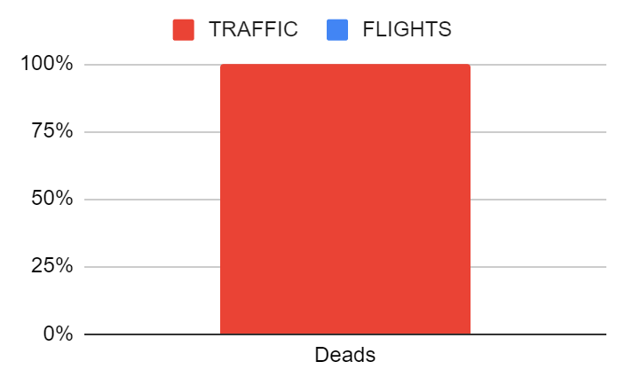
OBJECTIVE FACTS VS. EMOTIONS

Slide 18
PREVENTION
SO WHEN THINKING ON THE PROS AND CONTRAS OF PREVENTION WE SHOULD ALWAYS TAKE INTO ACOUNT THE MOST TRUSTABLE STATISTICS THAT WILL ANSWER WITH MORE ACCURANCY WHAT IS THE PROBABILITY OF HAVE ANY HARM IF I VACCINATE OR OTHERS UNDER MY TUTORSHIP OR I DON’T

Slide 19
STATISTICS
INDICATOR
SOURCE
SIGNIFICANCE
PRESENTATION

Slide 20
EXCESS MORTALITY
EXCESS MORTALITY SEEMS THE MOST ADEQUATE STATISTIC TO EVALUATE PANDEMICS EVOLUTION. WE HAVE EUROMOMO AS A COLLECTIVE EFFORT TO MEASURE IT

Slide 21
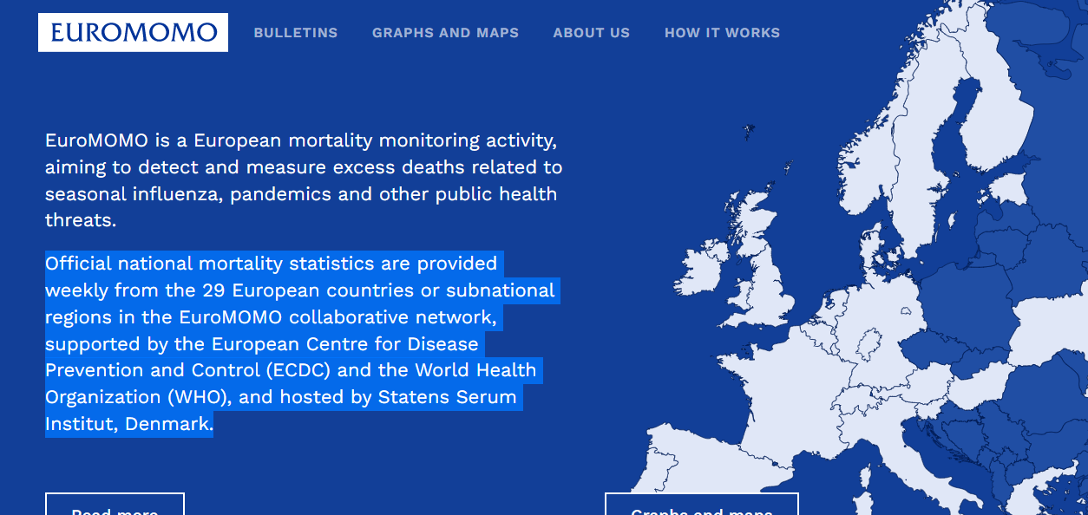
EUROMOMO

Slide 22
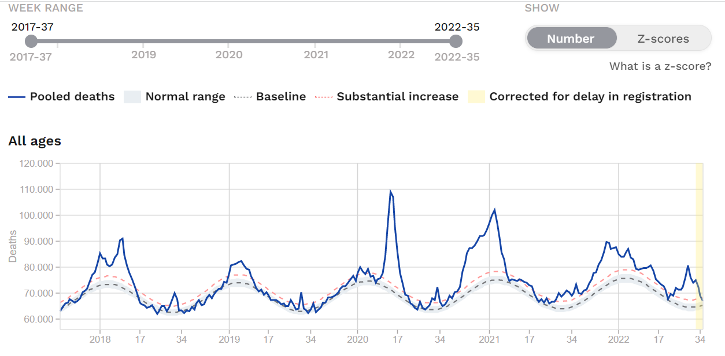

Slide 23
EUROMOMO

Slide 24
EUROMOMO

Slide 25
EUROMOMO

Slide 26
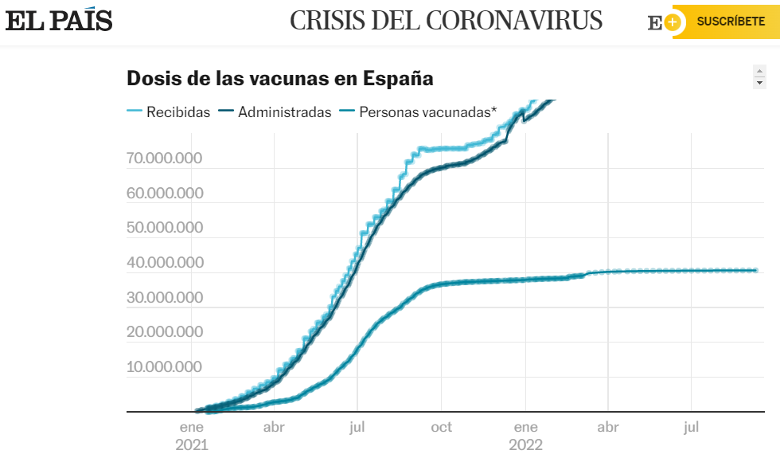

Slide 27
EUROMOMO

Slide 28
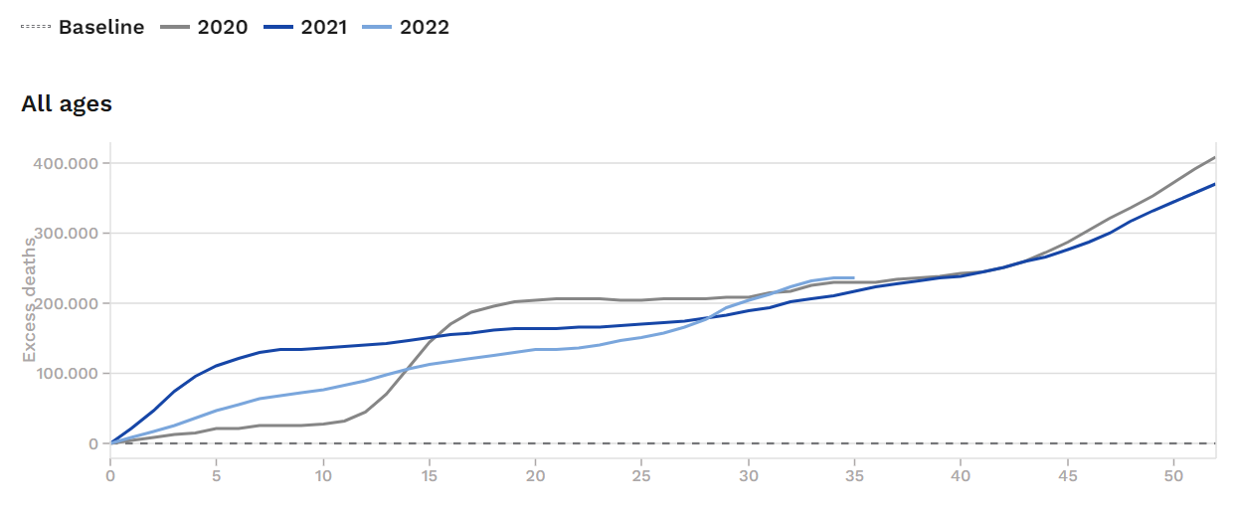
EUROMOMO

Slide 29
EUROMOMO

Slide 30
EUROMOMO

Slide 31
EUROMOMO

Slide 32
EUROMOMO

Slide 33
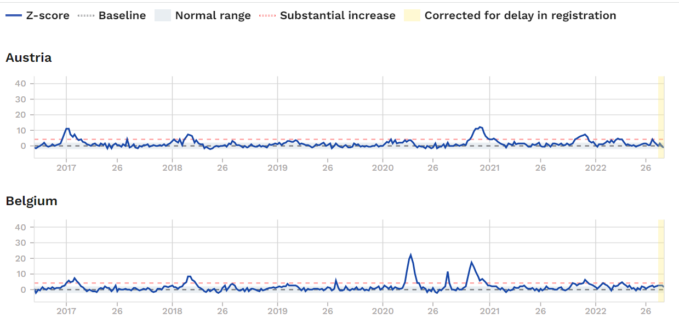
EUROMOMO

Slide 34
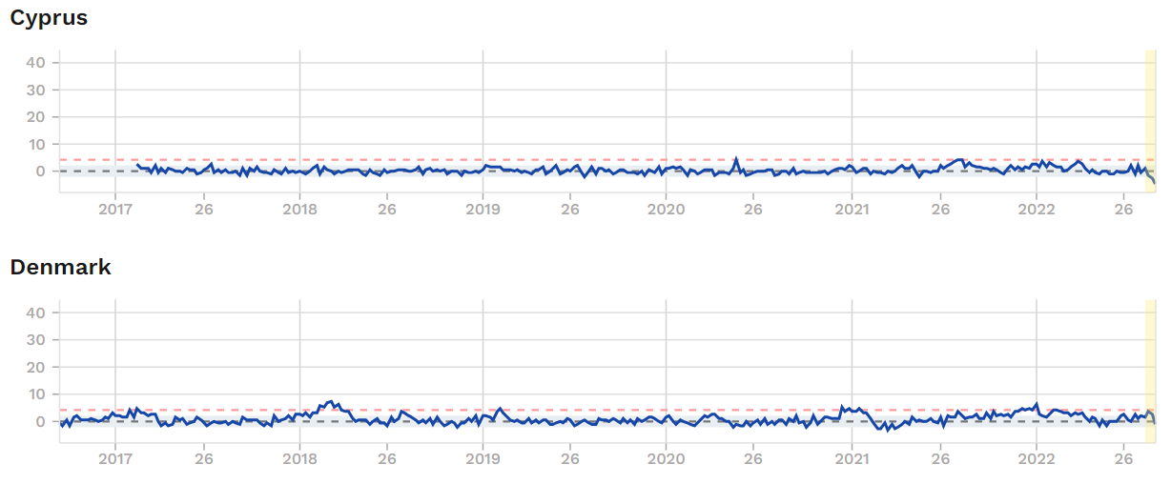
EUROMOMO

Slide 35
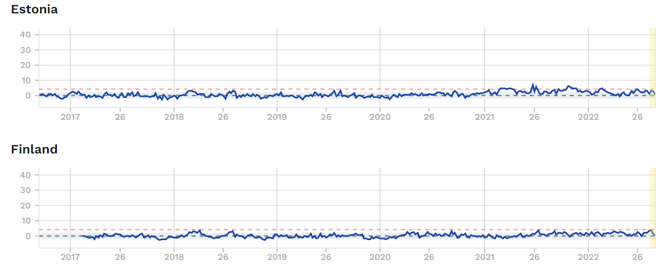
EUROMOMO

Slide 36
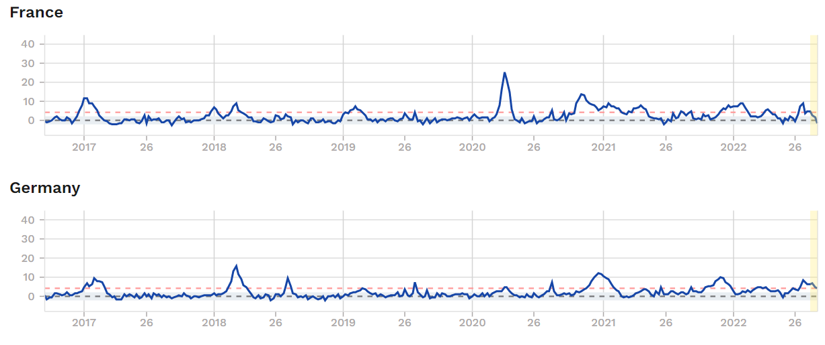
EUROMOMO

Slide 37
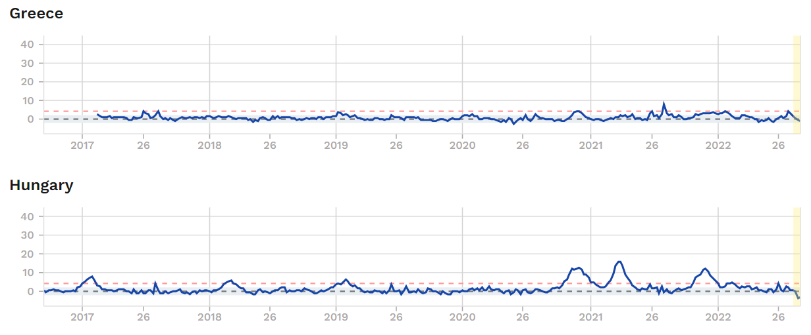
EUROMOMO

Slide 38
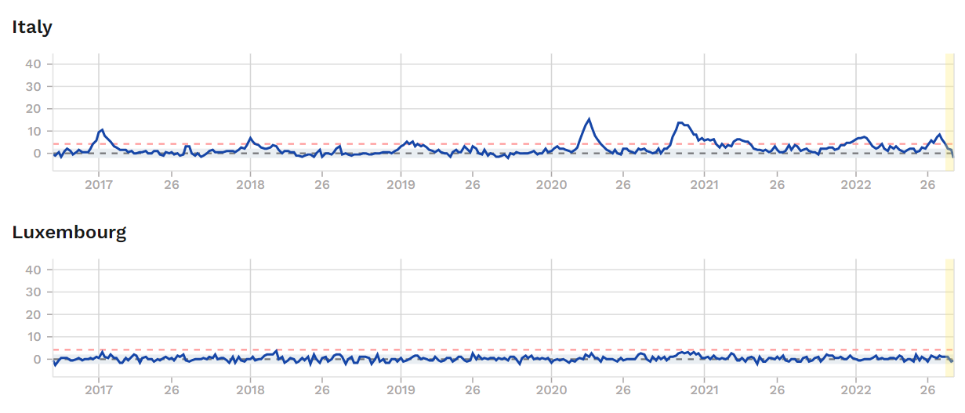
EUROMOMO

Slide 39
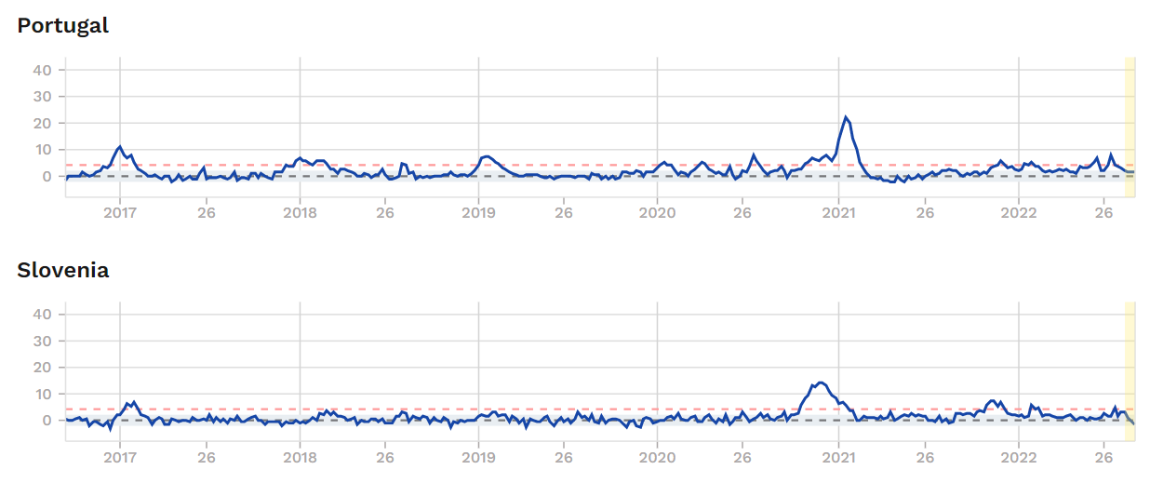
EUROMOMO

Slide 40
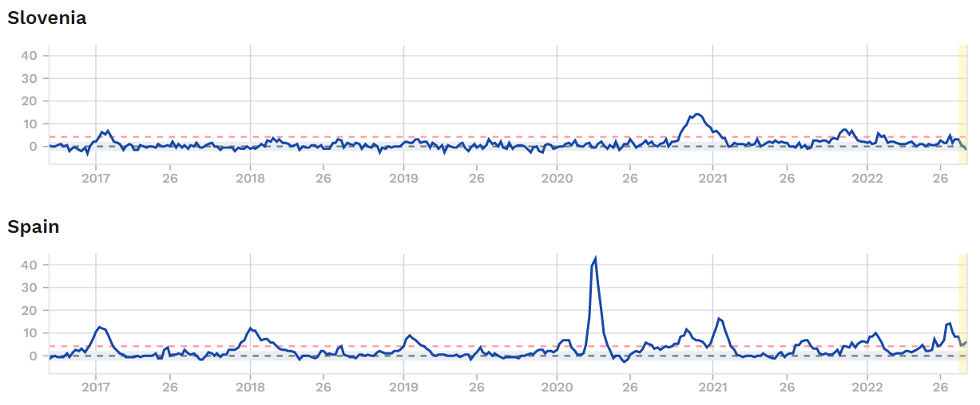
EUROMOMO

Slide 41
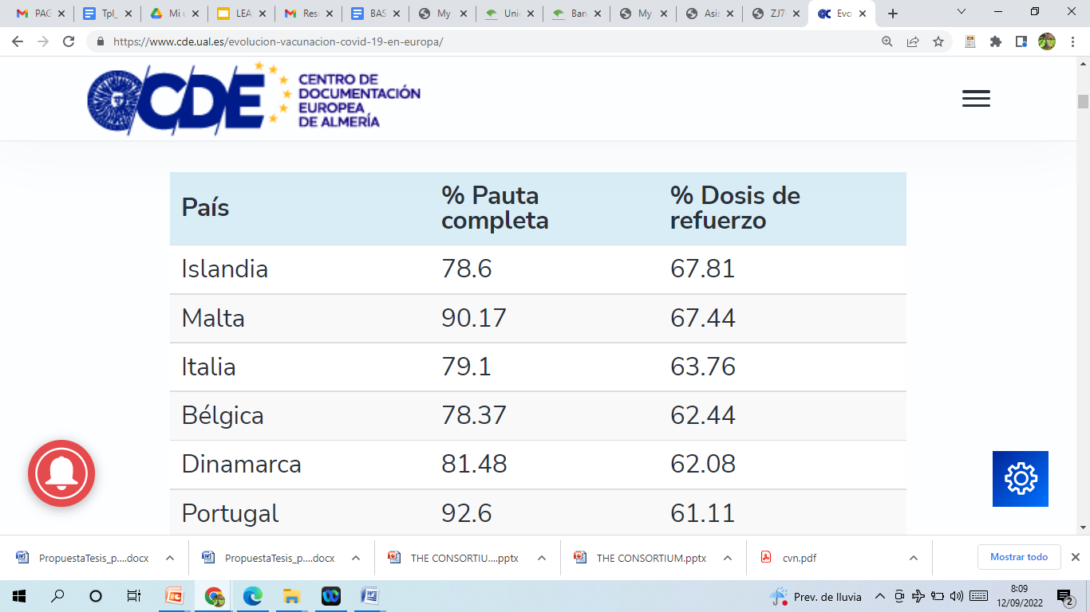

Slide 43
WITH THESE (MORE OR LESS) TRUSTABLE DATA (DON’T FORGET THE SYSTEMATIC DOUBT) THE (RURAL) CITIZEN CAN:
THINK ON THE PROBABILITY OF SERIOUS HARM ON PANDEMICS FOR EACH AGE RANGE
STUDY THE RELATIONSHIP BETWEEN VACCINATION AND DEADS (SO THE EFFECTIVITY OF VACCINATION)
TAKE DECISIONS ON ACTIONS FOR HIS/HERSELF AND HIS/HER RELATIVES

Slide 44
¡ Muchas Gracias !
mgu@unex.es

