Slide 1
Introduction to Decidim
“The European Commission’s support for the production of this publication does not constitute an endorsement of the contents, which reflect the views only of the authors, and the Commission cannot be held responsible for any use which may be made of the information contained therein.” 2020-1-ES01-KA227-ADU-096064
Notes:
Hello everyone I’m Federico, I’m graduated in Computer Science at Sapienza University of Rome and I collaborate with Polygonal as IT developer in many projects.
The Decidim platform ("We decide" in Catalan) is one of the most emblematic projects in the ecosystem of civic technologies. Born in Barcelona and initially financed by the municipality, it is built since its origins on the model of a common. The source code of Decidim is made available under the following license GNU GPL, which allows the reuse and evolution of the program as long as you share the identical modifications. But Decidim goes further by adding to the licence clauses, the adhesion to a social contract, setting out the additional "democratic safeguards" that must be respected when using the platform.

Slide 2
Decidim, a digital platform for citizen participation
A software for any actor eager to engage in a participative approach.
Online platform that allows the set up of participatory processes through its numerous functions.
Examples: participatory budget, debate, contribution space (allows users to "post" contributions), questionnaires/forms, etc. .
Allows organizations to have a digital tool dedicated to participation.
Demo
Notes:
Decidim helps citizens, organizations and public institutions self-organize democratically at every scale.

Slide 3
300+
🖥 platforms
deployed across 18 countries
Check the list.
100+
👩🏽💻Contributors
maintain the software and ensure its continuous evolution with several new versions released per year.
Check the Github.
30+
🤝 Partners
Decidim is a network of organizations (public institutions, universities, companies, foundations and associations).
See the list.
2
🏆 Second prize
for the most innovative open source software awarded by the European Union in 2019
See the tweet

Slide 4
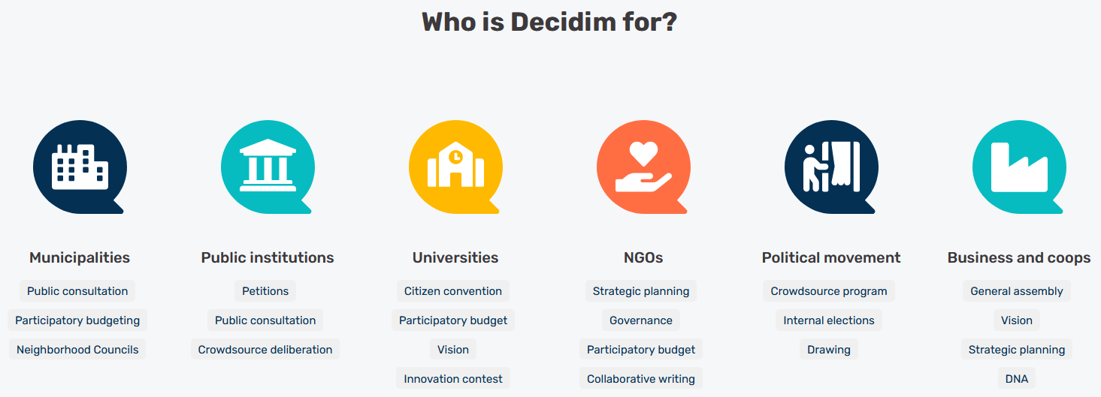

Slide 5
Free and open source software
Free and open source software
Everyone has the opportunity to adapt the software, improve it or analyze its code.
Promise of greater quality (continuous improvement), greater security (the code can easily be tested and corrected) and total transparency.
Enables the development of a more open and participatory democracy.
Builds trust: data management, transparency, etc.

Slide 6
Four areas allowing the creation of functionalities and content: Processes
A participatory process is a sequence of participatory activities (e.g. first filling out a survey, then making proposals, discussing them in face-to-face or virtual meetings, and finally prioritizing them) with the aim of defining and making a decision on a specific topic.
Notes:
To democratize common issues, step by step. Processes is a space that allows to create, activate/deactivate, and manage various participatory processes. These are distinguished from other spaces by being structured in different phases within which all of the components can be incorporated. Examples of participatory processes are: an election process for members of a committee, participatory budgeting, a strategic planning process, the collaborative writing of a regulation or norm, the design of an urban space or the production of a public policy plan.

Slide 7
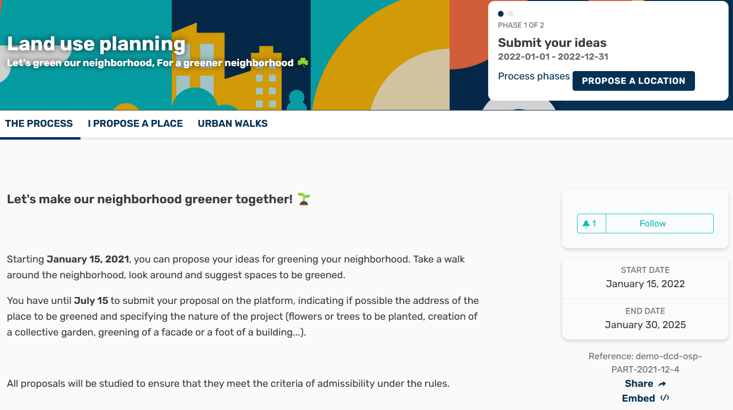

Slide 8
Four areas allowing the creation of functionalities and content: Assemblies
The Assemblies are better
suited to a participatory
governance over a long period of time.
An assembly is a group of members of an organization who meet periodically to make decisions about a specific area or scope of the organization.
Assemblies hold meetings, some are private and some are open. If they are open, it is possible to participate in them.
Notes:
The power of collective self-organization
Makes it possible to set up decision-making bodies or groups (councils, working groups, commissions, etc.) that meet regularly, detailing their composition, listing and geolocating their meetings. It allows participation in them, for example, attending in person or online, adding issues to the agenda, or commenting on the proposals and decisions taken by that body.

Slide 10
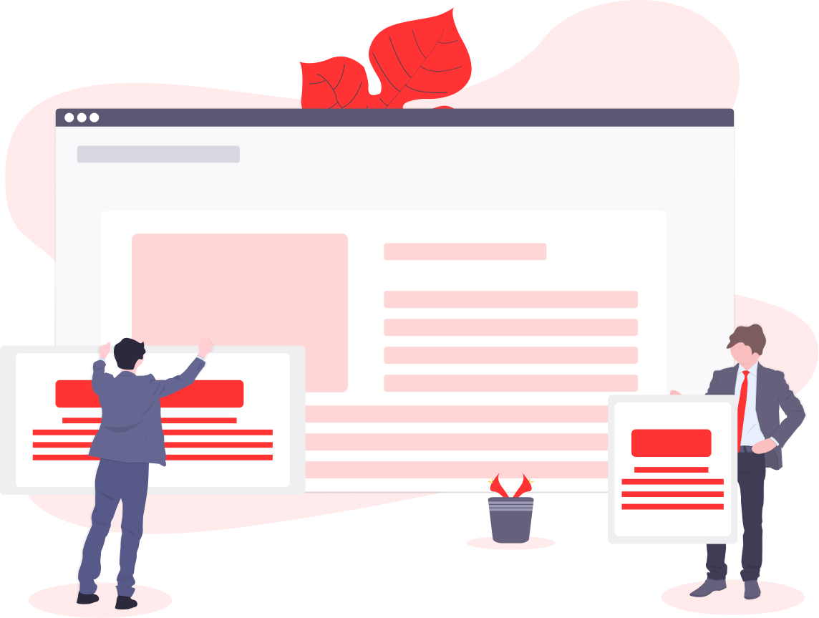
Four areas allowing the creation of functionalities and content: Initiatives
An initiative is a proposal that can be promoted by any person on their own initiative through the collection of (digital) signatures for the organization to carry out a specific action (change a regulation, initiate a project, change the name of a department or a street, etc.).
Notes:
Setting everyone's agenda, within everyone's reach
Participants can create collaborative initiatives, define their path and goals, gather endorsements, discuss, debate and disseminate initiatives, set meeting points where signatures can be collected from attendees or debates open to other members of the organisation.

Slide 11
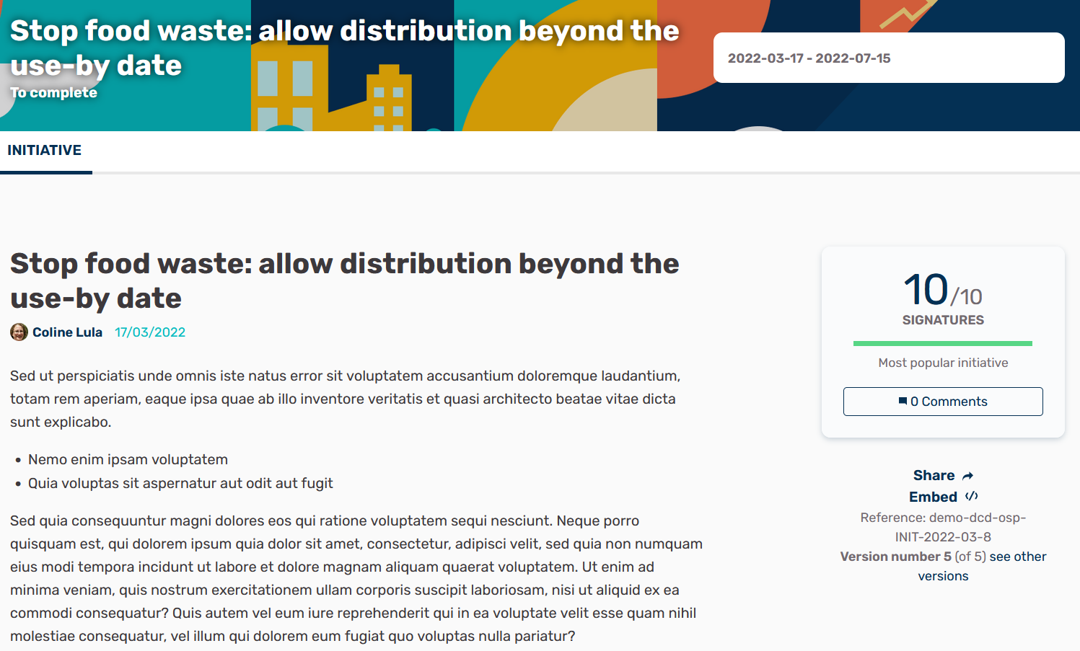

Slide 12
Four areas allowing the creation of functionalities and content: Votings
The Votings allow for the implementation of referendums.
The Conferences allow you to enter information about a particular event in order to provide a maximum of detail on the programme, benefit from a more developed registration module, etc.
Notes:
The right to decide with all democratic guarantees
Makes it possible to coordinate referendums, trigger discussions and debates, get voting results published and connect to a secure e-voting system.

Slide 13
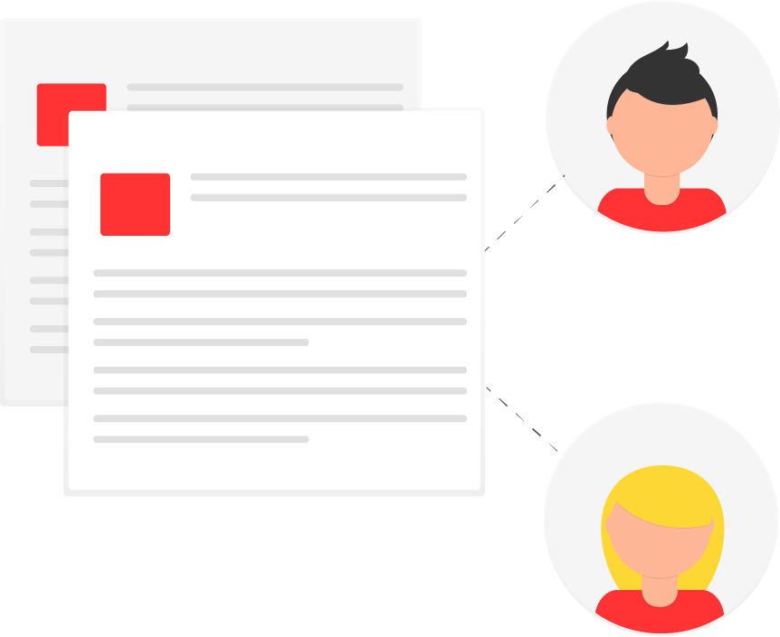
Numerous participation modules: Proposal
Proposal: allows for the creation of a participatory space for users to post a contribution/idea/proposal; to vote for proposals; to support proposals (equivalent to the "Like" functionality); to comment on proposals; to filter proposals, etc.
Notes:
There are other “components that can be implemented, ProposalsCreate a proposal using a creation wizard, compare it with the existing ones, publish it on the platform and include additional information such as geolocation or attached documents and images. This component also allows you to navigate, filter and interact with a set of proposals. In addition, with the proposal-incubator you can create collaborative proposals.

Slide 14
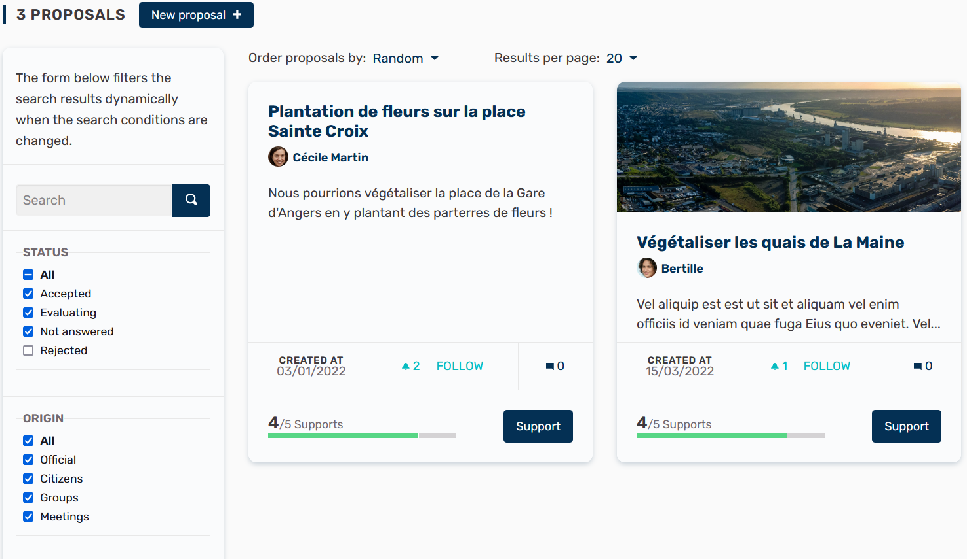

Slide 15
Numerous participation modules: Meetings
Meetings: allows you to highlight an event (workshop, public meeting, debate, etc.) by indicating its date, location, description/objectives and/or by integrating visuals (posters, "flyers", etc.).
Notes:
The meeting component offers organizations and participants the opportunity to convene meetings, determine their location and time, register and limit attendees, define the structure and content of the meeting as well as publishing the minutes, and the resulting proposals.

Slide 17
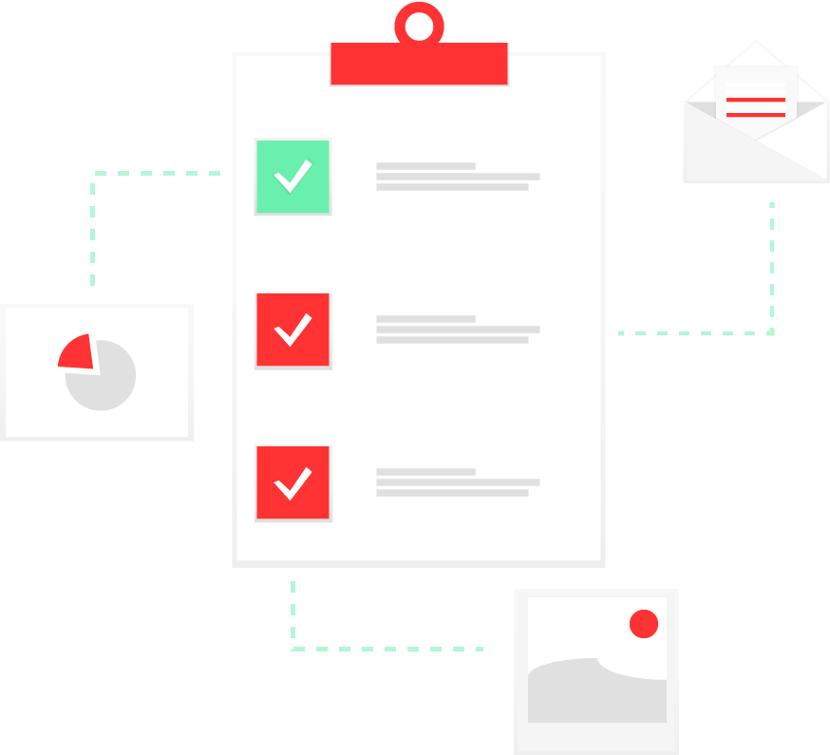
Numerous participation modules: Survey
Survey: Create surveys/forms/questionnaires and choose how to answer them: single choice; multiple choice; short answer; long answer; sort in the desired order. This feature allows you to easily set up a registration form, questionnaire or survey that lends itself to the format.
Notes:
Design and publish surveys. Display and download results.

Slide 18
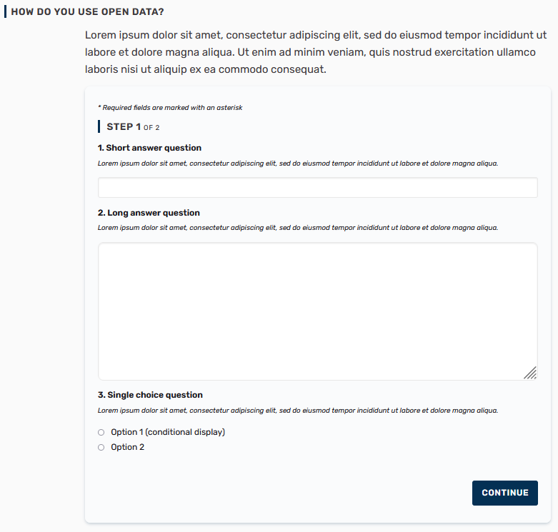

Slide 19
Numerous participation modules: News, Debates & Budgets
News: allows you to organize a "blog" type section on the platform, allowing users to comment on the different articles and the administrators to communicate.
Debates: enables open debates initiated by the administrator and/or by users through a comment thread.
Budgets: enables the set up of a participatory budget after a submission of proposals by users or by the administrator. Users can thus vote for different projects, follow the budget and its evolution, etc.
Notes:
Create informative pages with rich text formatting, embedded pictures and videos. The blog component makes possible the creation of posts or news, and to navigate them chronologically

Slide 20
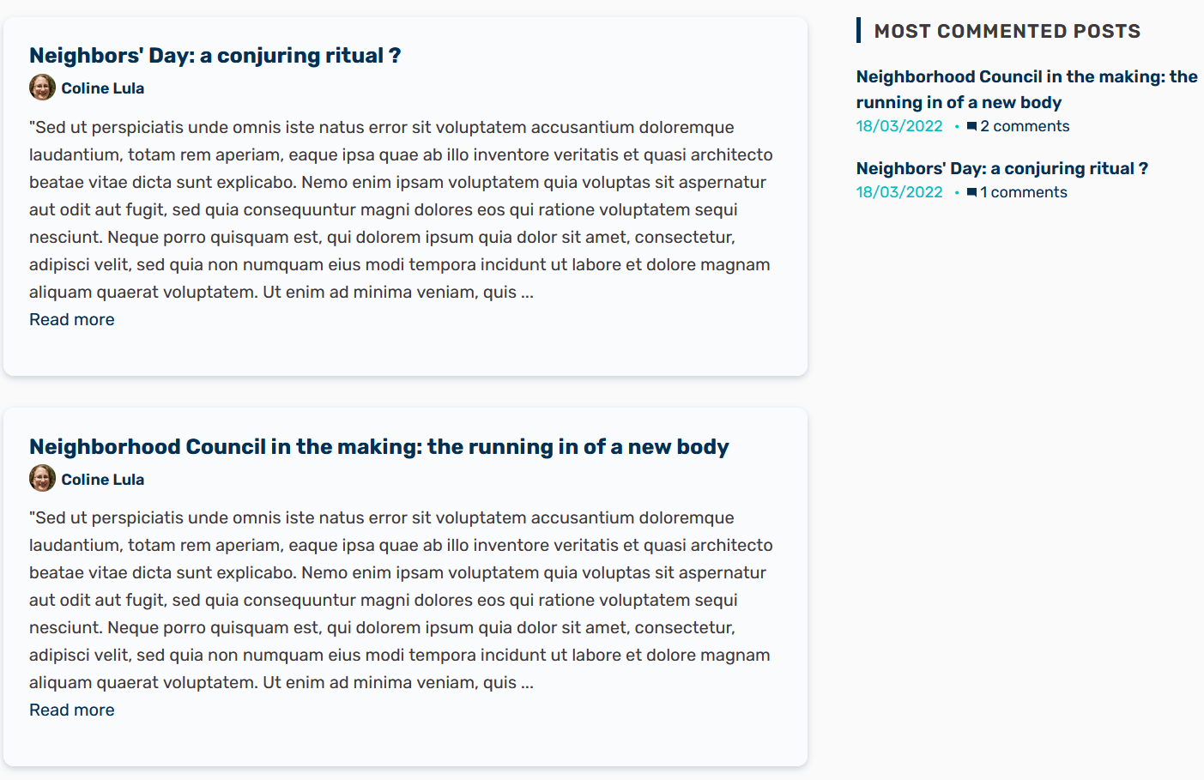

Slide 21
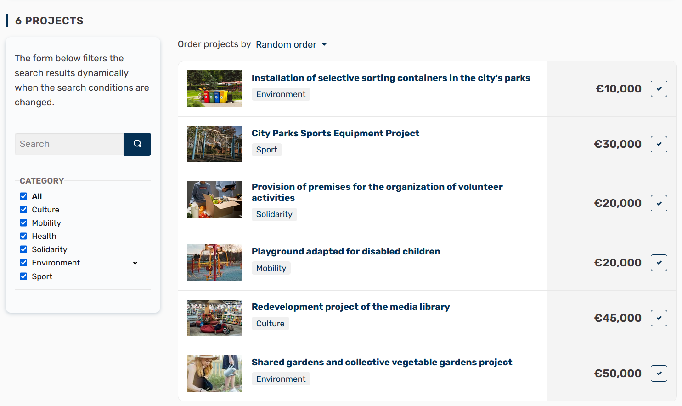

Slide 22
Numerous participation modules: Page, Random selection & Follow-up
Page: create and edit pages that inform the user about the platform administrator, the current consultation, the methods of participation, the objectives, etc.
Random selection: allows you to draw lots for applications/proposals. For example, it can be useful to create assemblies by random selection.
Follow-up: The "Follow-up" functionality allows users to monitor the progress of implementation (overall, by category and/or by sub-category) of an action linked to a concertation.

Slide 23
Advantages of the Decidim platform
A social and engaging dimension: User profiles enables the development of a form of a social network, including the possibility for users to subscribe to a profile, exchange messages, create user communities, etc.
A transparent participatory path from the submission of an idea to its realization
An inclusive and accessible platform through the combination of digital technologies and face-to-face interaction

Slide 24
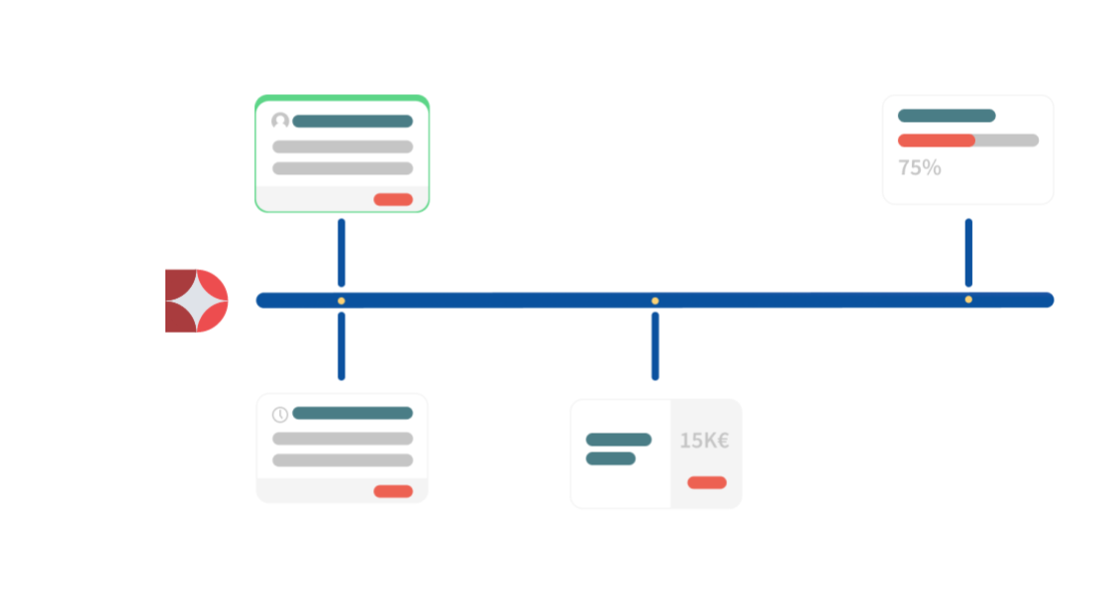
I submit my idea on the platform
Decidim Platform
I am the realization of the project to which I contributed
I participate in a face-to-face workshop
I vote on the investment project where my idea is integrated

Slide 25
Thanks for your attention
“The European Commission’s support for the production of this publication does not constitute an endorsement of the contents, which reflect the views only of the authors, and the Commission cannot be held responsible for any use which may be made of the information contained therein.” 2020-1-ES01-KA227-ADU-096064

